Slide 1
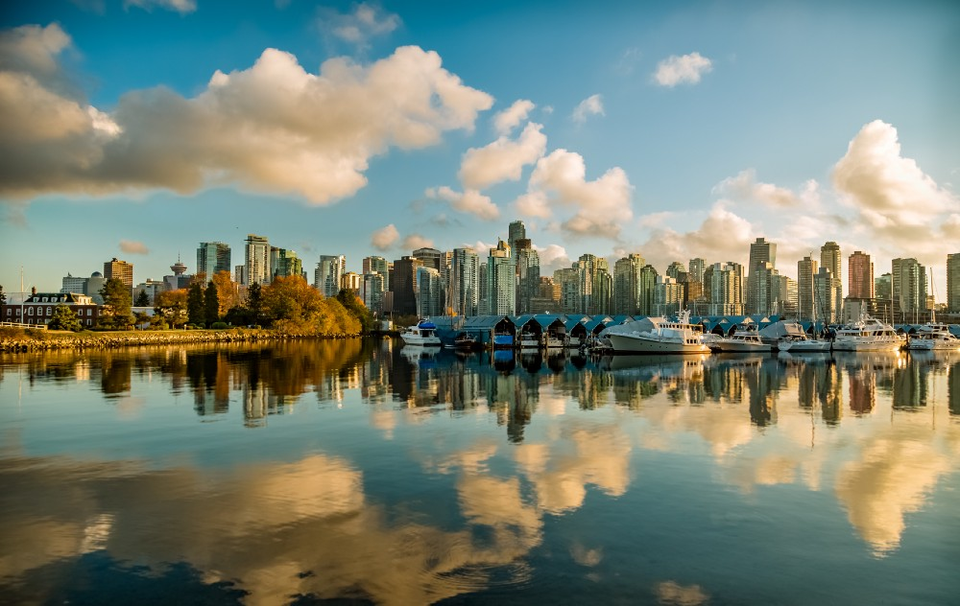
Location optimization for establishing a new Chinese restaurant in Vancouver city areas
Tan Yan Houng
Story posted on Medium

Slide 2
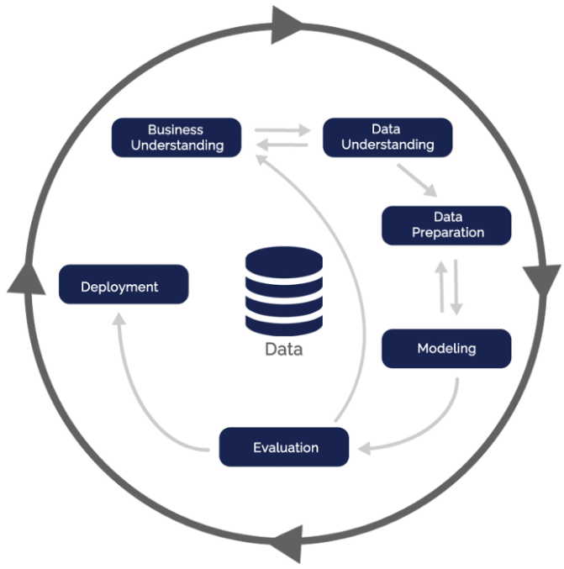
Data Science Methodology
Business Understanding
Understand the business problem
Data Understanding
Study of the data collected
Data Preparation
Data pre-processing
Modelling
Build machine learning models
Evaluation
Evaluate the models built
Deployment
Implementation into actual usage
CRISP-DM (1996)
CRoss-Industry Standard Process for Data Mining

Slide 3
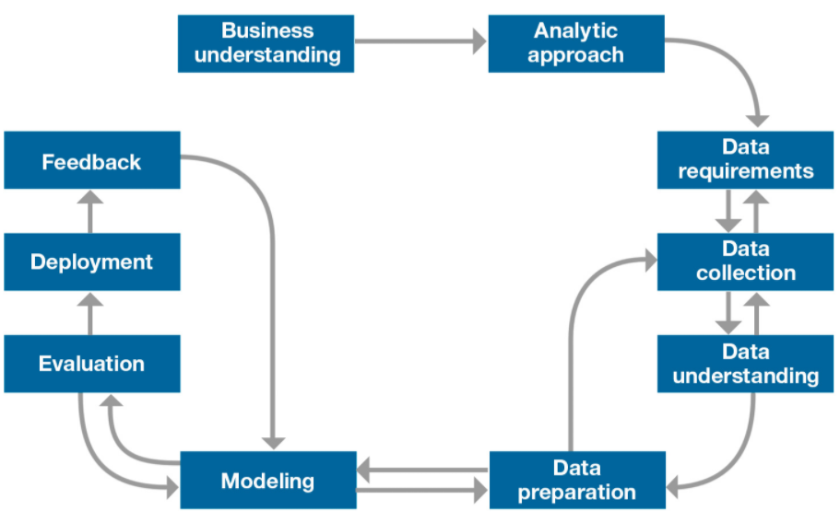
Data Science Methodology
IBM Foundational Methodology for Data Science

Slide 4
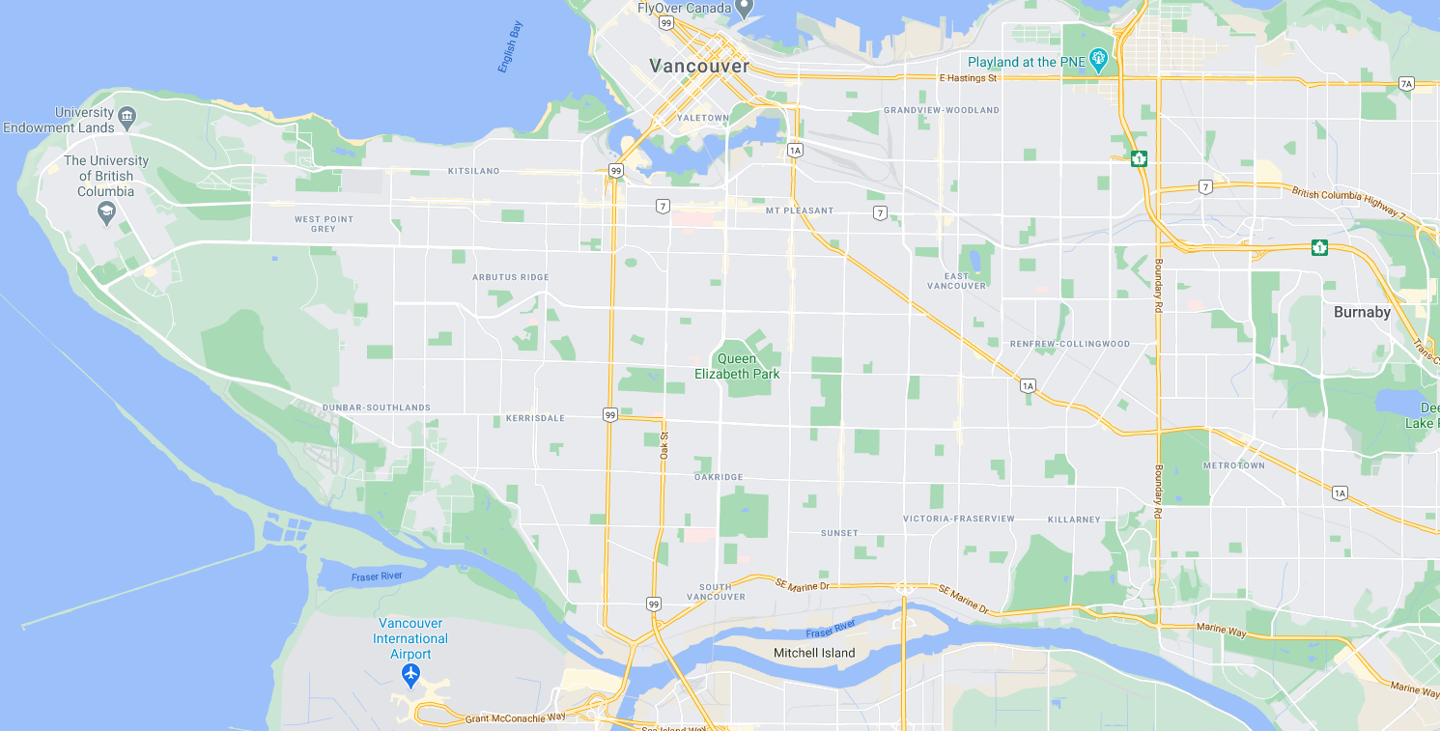
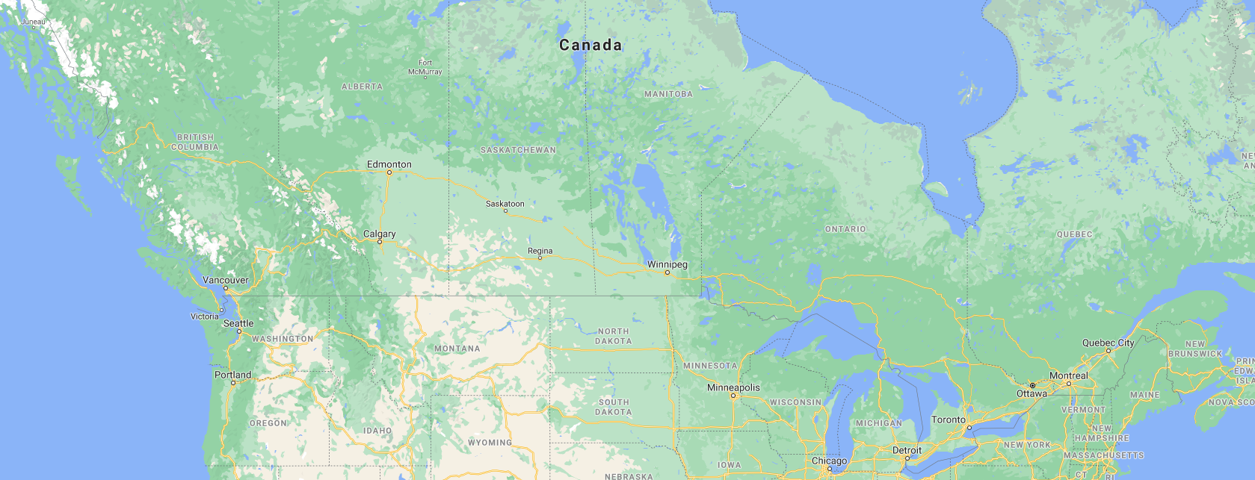
Introduction :
Vancouver city is one of the big cities in Canada located in the west.
Vancouver CSD (Census Subdivision), Vancouver city consists of 22 neighborhoods.
Vancouver city is a multicultural city. It is formed by a mix of people who are of different races, having different religions, ethnicities, and cultural.

Slide 5
Business Problem :
There are 167180 Chinese people staying in Vancouver city.
Establishing a Chinese restaurant → a good choice of investment.
As an investor, it is always important to find an optimal place to establish a Chinese restaurant.
Need to scan through the neighborhood of Vancouver CSD to identify establishing a Chinese restaurant in which area will higher business opportunities and lesser competition.
Target audience :
Investors who want to establish a new Chinese restaurant in Vancouver CSD.

Slide 6
Data Sources :
City of Vancouver census local area profiles 2016
https://opendata.vancouver.ca/explore/dataset/census-local-area-profiles-2016/information/
Access of the data in Vancouver city
Geocoder (Python library)
To retrieve the latitude and longitude for each neighborhood in Vancouver city
Foursquare API
To explore the famous venues exists in the neighborhoods of Vancouver CSD

Slide 7


Data Pre-processing :
Data Cleaning
The data collected usually consists of many errors such as NaN (Not a Number – missing value), incorrect value (typo mistake during data entry) and etc.
The data may contains too many irrelevant information.
Using Foursquare API (Application Programming Interface)
Foursquare is a social networking service application for smartphones.
Foursquare is to help in discovering and sharing information about businesses and attractions around a location.
Foursquare API allowed us to extract the data in exploring the businesses and attractions around the location that we set.

Slide 8
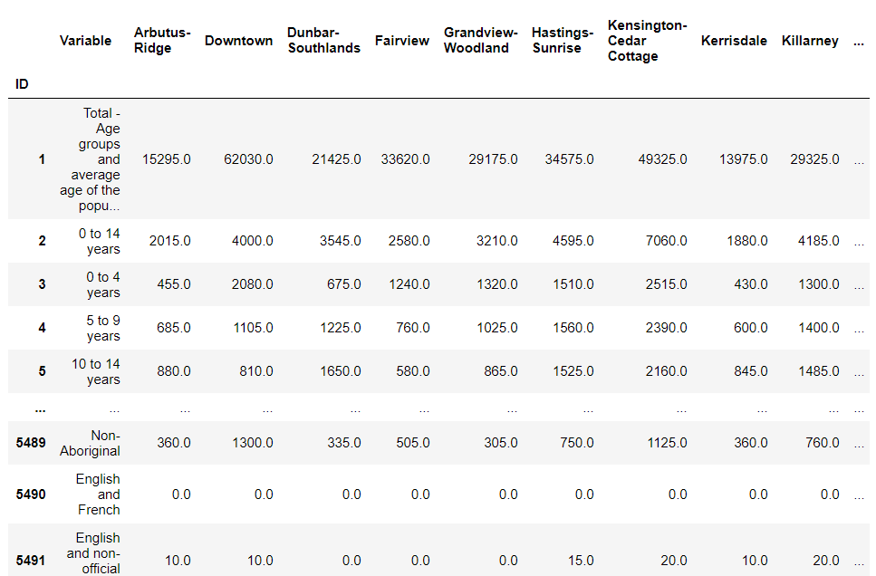
Data Pre-processing :
Data Cleaning
22 local areas + CSD total & CMA total
5491
different data categories
City of Vancouver census local area profiles 2016
Note : CMA = Census Metropolitan Area

Slide 9
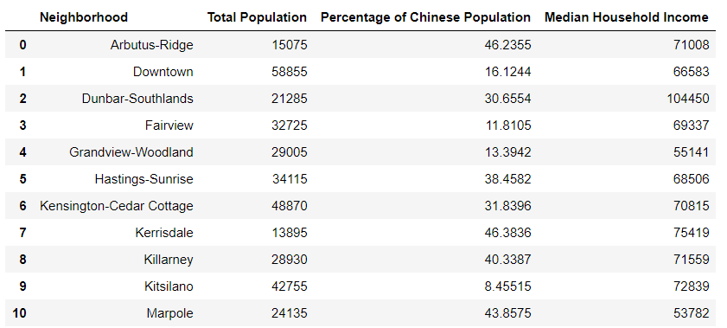
Data Pre-processing :
Data Cleaning
We are focusing on the following data :
The 22 neighbourhoods in Vancouver city
The total population in each neighbourhood
The Chinese visible minority in each neighbourhood
The household income for each neighbourhood

Slide 10
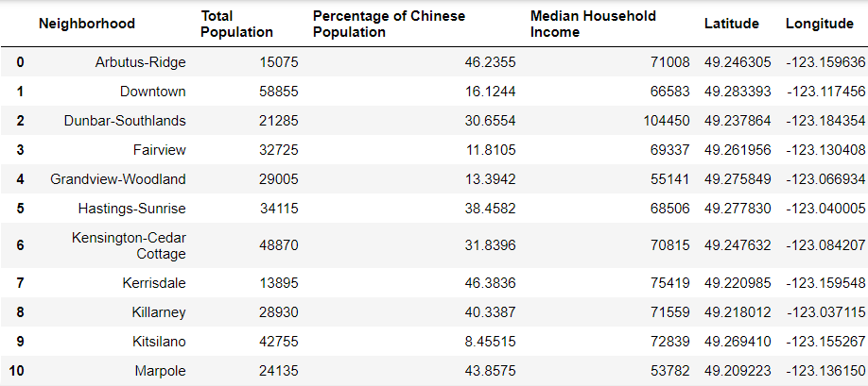
Data Pre-processing :
Data Cleaning
Using geopy.geocoder.Nominatim package in Python, we are able to get the latitude and longitude information for each neighbourhood in Vancouver CSD.

Slide 11
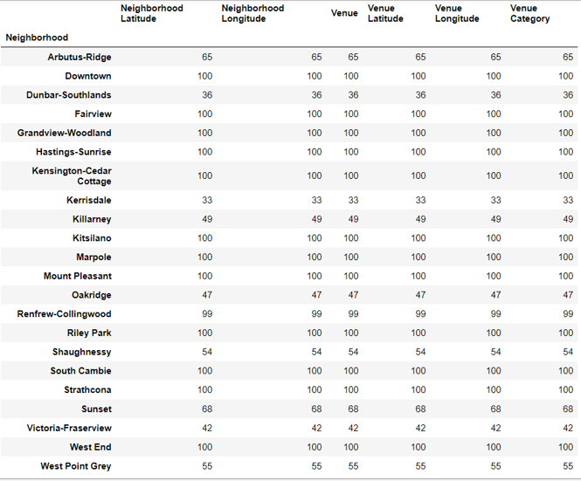
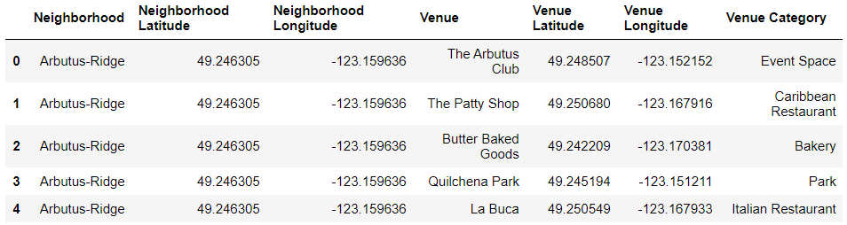
Data Pre-processing :
Using Foursquare API
To extract the special venues around the neighbourhoods of Vancouver city using the latitude and longitude data we have gotten.
Radius of exploration = 1.5 km
Maximum limit of venues = 100
Some venues explored in Arbutus-Ridge neighbourhood

Slide 12
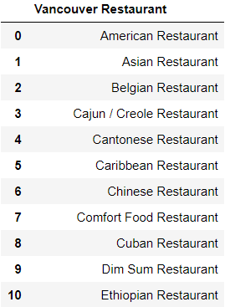
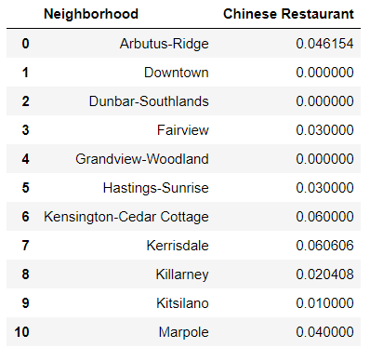
Data Pre-processing :
Using Foursquare API
Summarised the venue category and sorted out for different types of restaurant.
Combined 3 restaurant data and calculate frequency of occurrence of Chinese Restaurant.
Total 43 types of restaurant in Vancouver

Slide 13
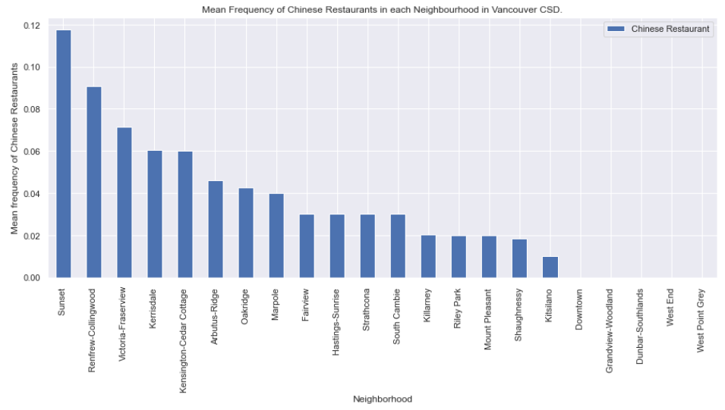
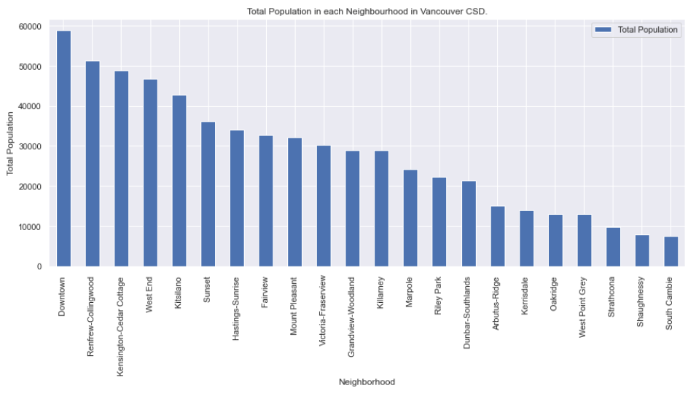
Data Visualization:
Bar Chart
High competition for Chinese restaurants → lower priority area to choose
Higher population will bring more business to a restaurant

Slide 14
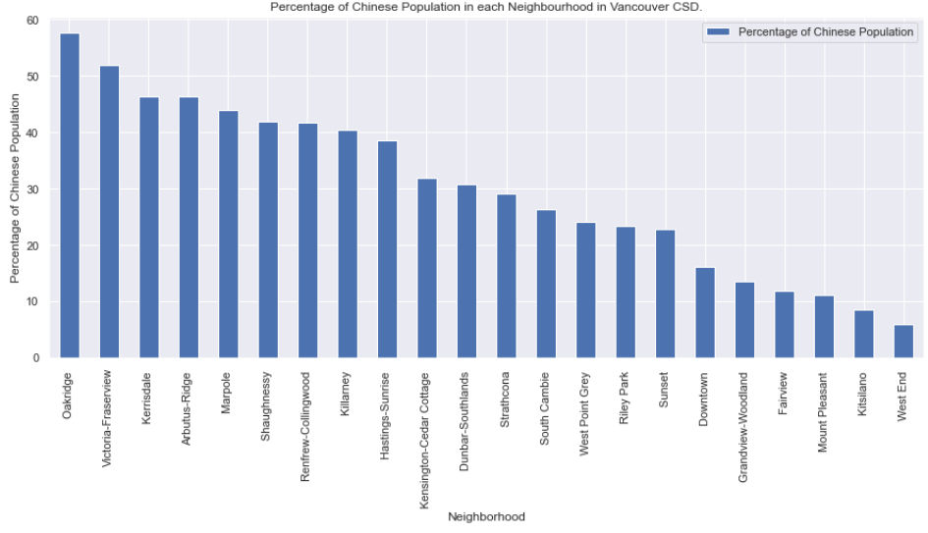
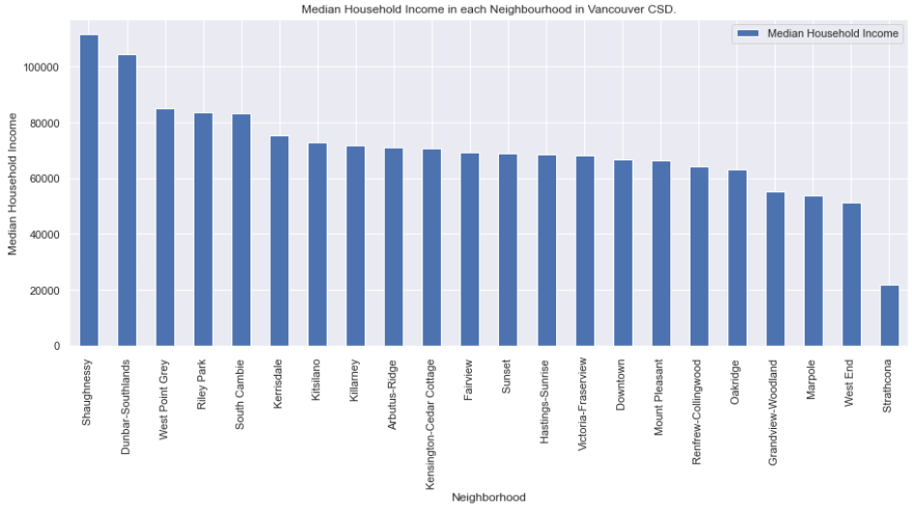
Data Visualization:
Bar Chart
Chinese people will prefer Chinese foods
Higher Chinese population → more business
Higher household income → higher spending power, more likely to have meal in restaurant

Slide 15
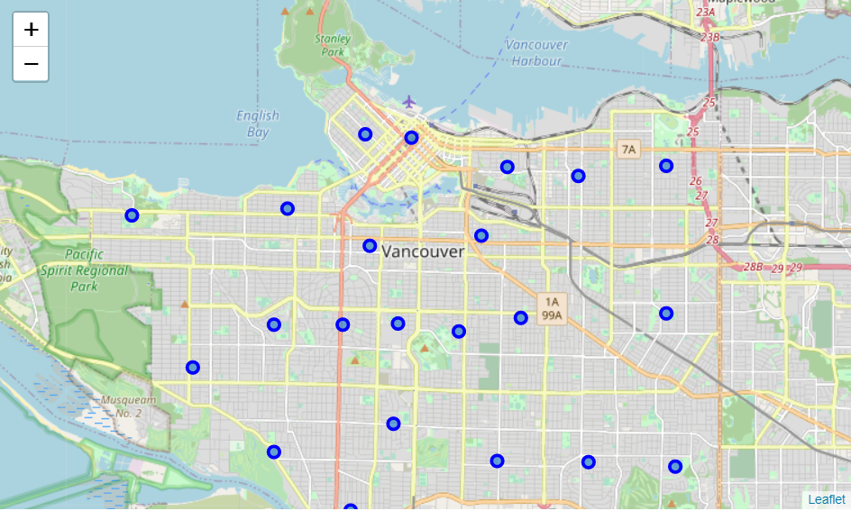
Data Visualization:
Map visualization
Using folium package, the Vancouver city map can be generated.
All 22 neighbourhoods in Vancouver CSD.

Slide 16
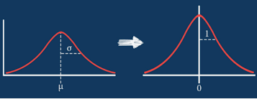
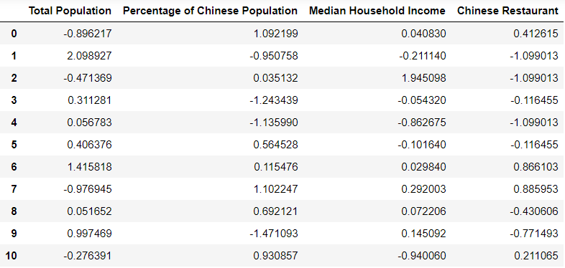
Machine Learning Modelling – Clustering problem:
Feature scaling for all the features
The features to be used for clustering model are :
Total population
Percentage of Chinese population
Household income
Frequency of Chinese restaurant
Standardization
Different mean, different variance
68%
-1
1

Slide 17
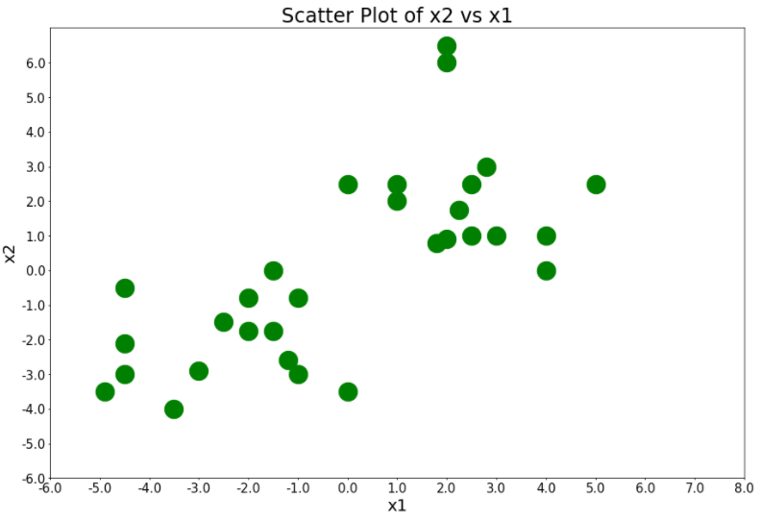
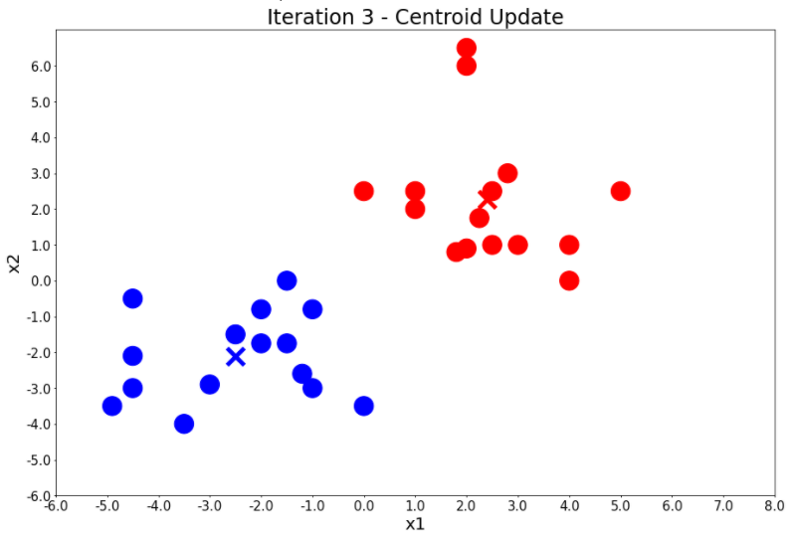
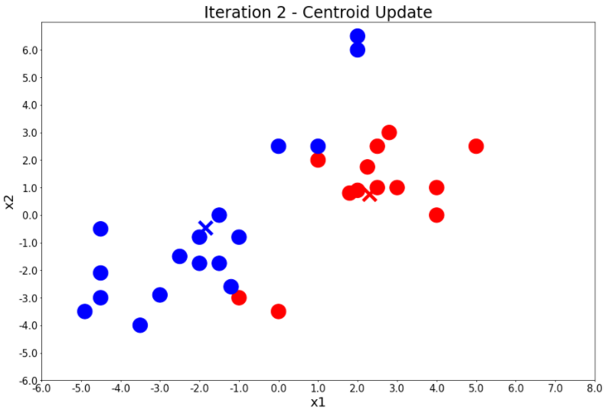
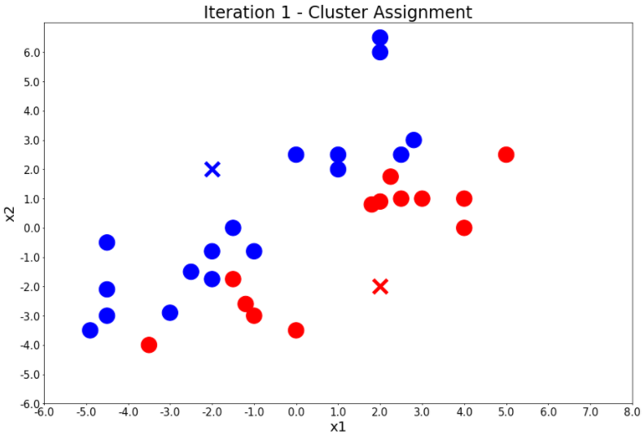
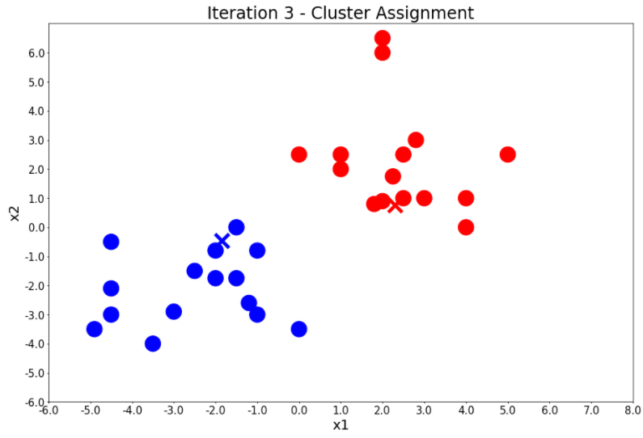
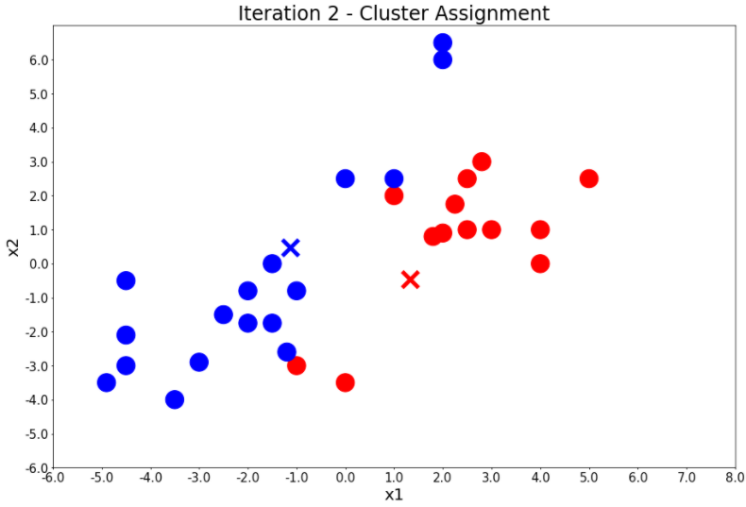
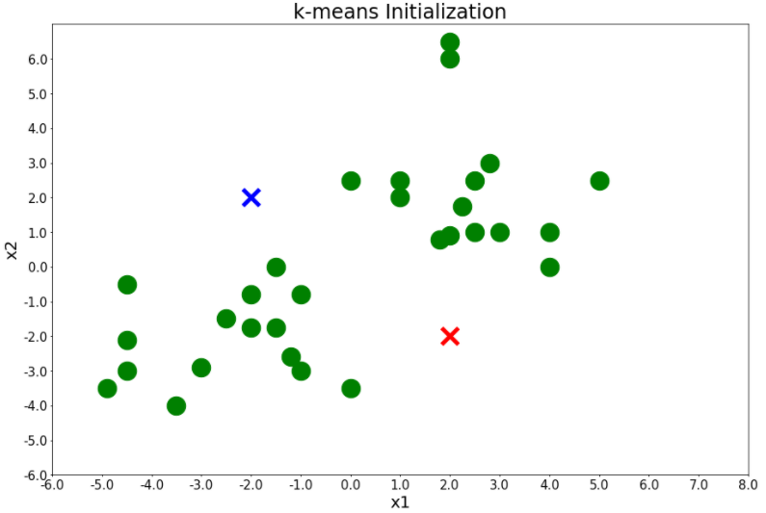
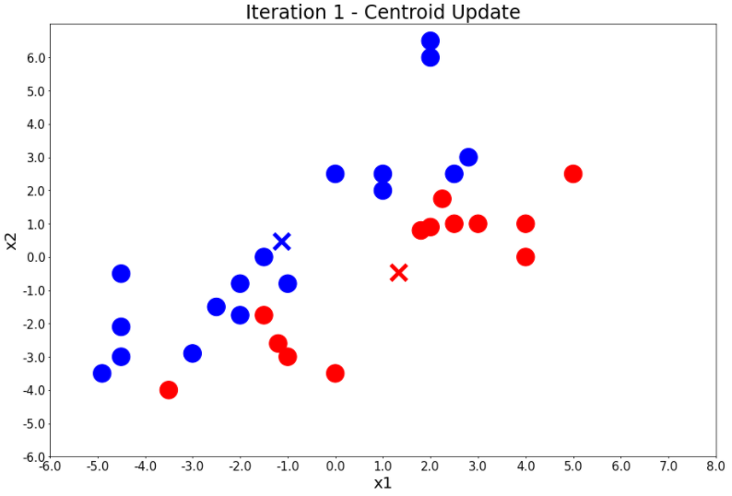
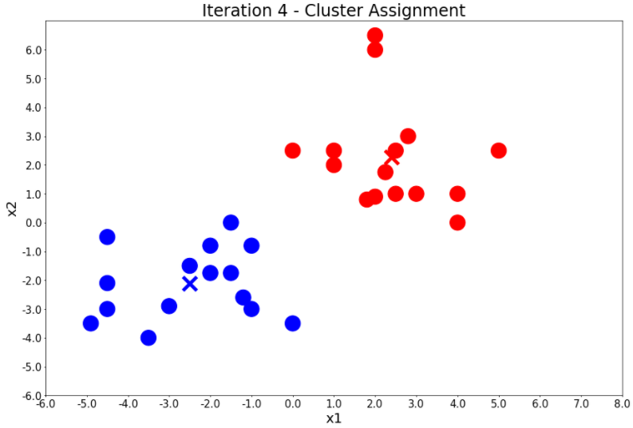

Machine Learning Modelling – Clustering problem:
K-means clustering algorithm
One of the simplest unsupervised machine learning algorithm
Need to specify the number of clusters, K
Example:
Random centroids initiation
For each point, compare the distance to different centroid
Assign point to closest centroid
Update centroid position
Repeat steps 2 – 4 until all iterations completed

Slide 18
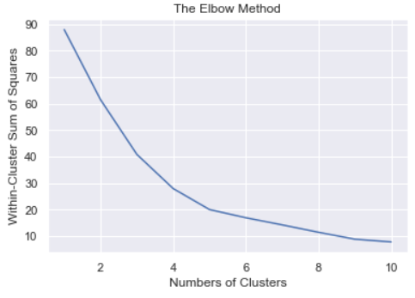
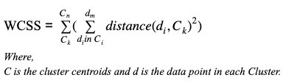
Machine Learning Modelling – Clustering problem:
K-means clustering algorithm
How to find the best number of clusters, K ?
The elbow method
Decide a range of K
Run K-means algorithm
Calculate the WCSS (within-cluster sum of square)
Best K = 5
The best number of clusters, K is
with a low WCSS and a low K value

Slide 19
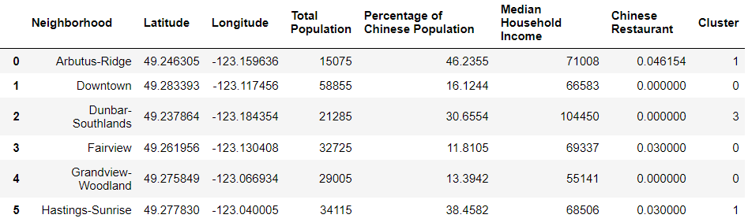
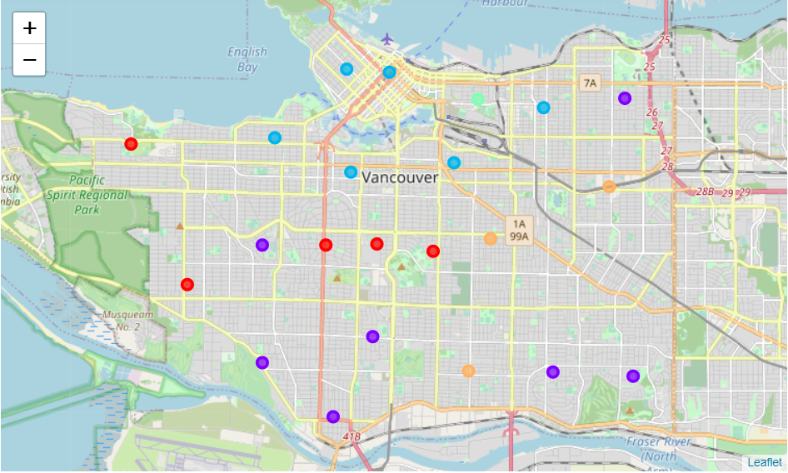
Results :
with K = 5, we are able to get the cluster group for each neighbourhoods in Vancouver city.
Cluster :
0
1
2
3
4

Slide 20
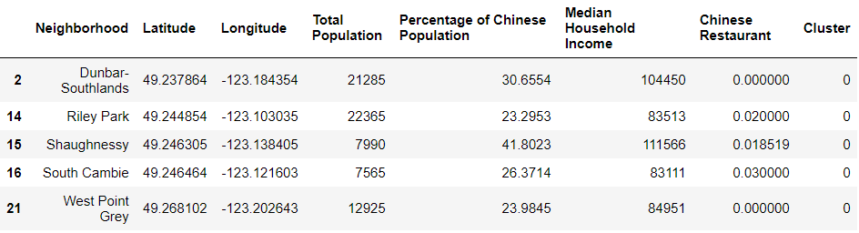
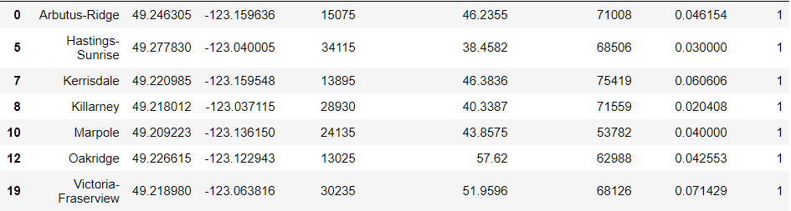
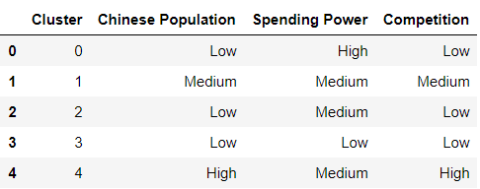
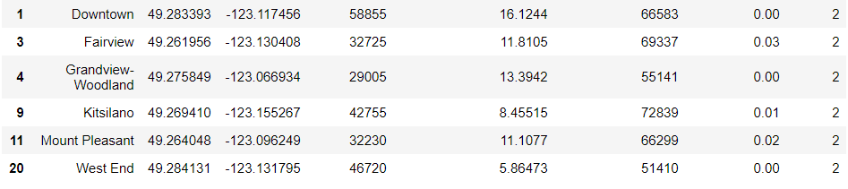
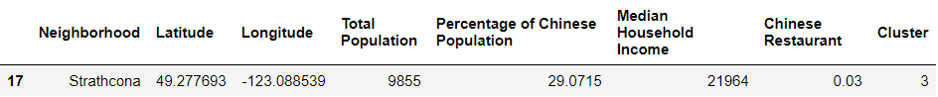
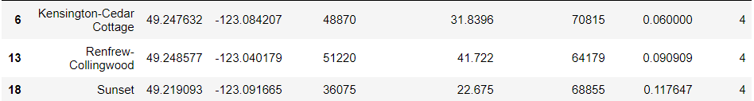
Results :
Frequency of Chinese Restaurant
Household income

Slide 21
Conclusion :
Low Chinese population → less business for Chinese restaurant
The best choice to establish a new Chinese restaurant : Cluster 1 neighbourhoods
Medium Chinese population with medium spending power and the Chinese restaurant competition there is not as competitive as Cluster 4.
2nd choice : Cluster 4 neighbourhoods
Although the Chinese restaurant competition here is very competitive, the Chinese population is also high at these neighbourhoods.
The high Chinese population can overcome the competition here.

Slide 22
Conclusion :
Cluster :
0
1
2
3
4

Slide 23
Thank you

